Slide 1
How to edit an HTML widget on AU pages
How to use the HTML widget and CSS in the system

Slide 2
Process Info
Owner name | Annarose Peterson
Team | Production
Resources | Docebo
Tools | Docebo, HTML editing software
Description | HTML widgets are used to create experiences on the pages, this guide shows the best way to edit the widgets we use
 | AU Member | AU Member | AU Member | AU Member | AU Member | AU Member | AU Member | AU Member | AU Member
Date

Slide 3
Steps
Create framework with the HTML editing software
Add a new HTML widget to a page or open existing HTML widget to edit it
Paste framework HTML to widget
Use WYSIWYG editor to add images (and hyperlink to images)
(Optional) Add CSS to be used on HTML widget
Update HTML for CSS as necessary
HTML Widget tips and best practices – Click to Access

Slide 4
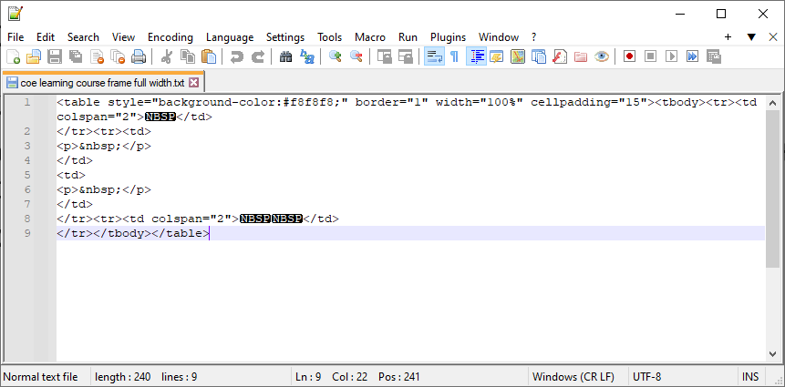
Step 1 Create Framework of HTML
The size of the editing area of the HTML widget is small, so it is recommended to use an HTML editor (such as Notepad++ or Adobe Dreamweaver) to build the framework.
Example framework:

Slide 5
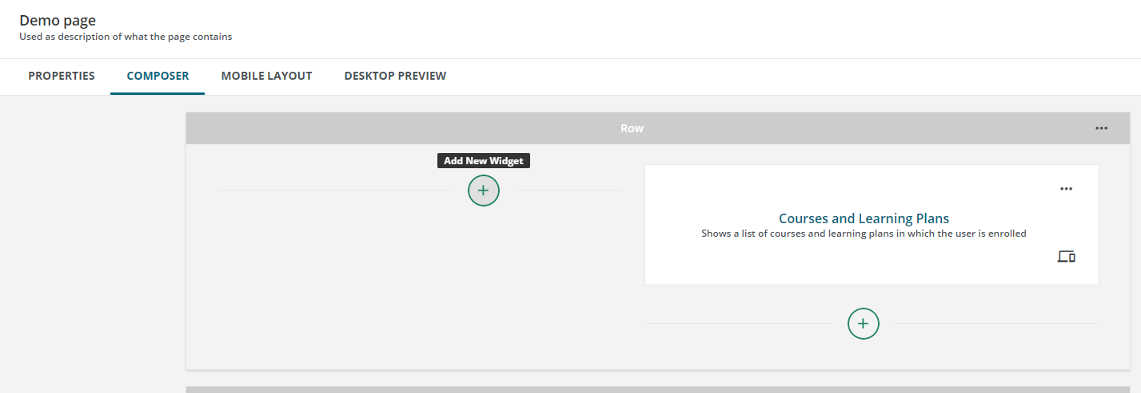
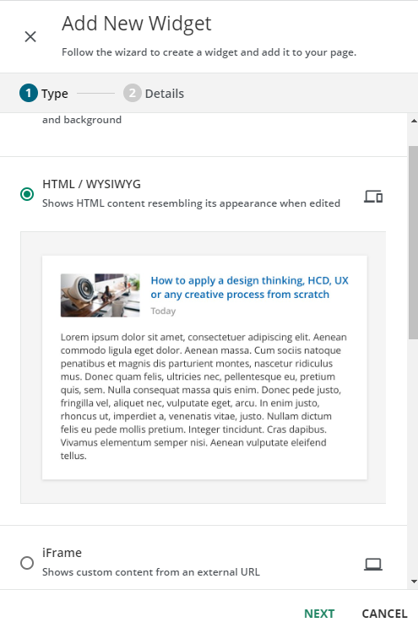
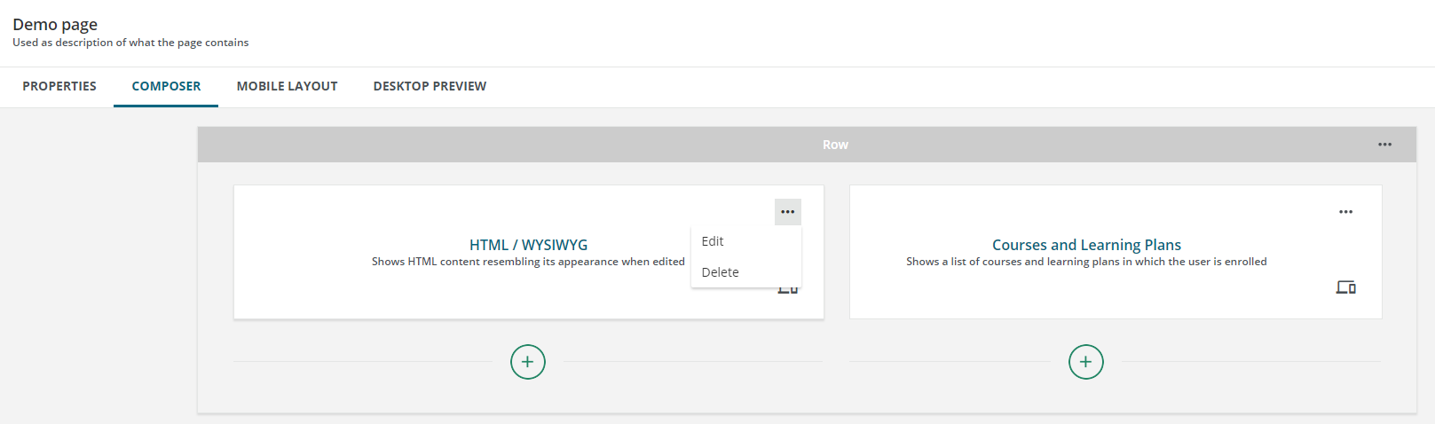
Step 2
Access page and select page you are editing (full instructions on how to complete this step are found here: How to set up pages in AU.pptx)
To add new widget:
Click plus on open area on row
Select HTML/WYSIWYG
Click Next
To open existing:
Click on ellipsis on existing widget
Select Edit
1
2
1
2
3

Slide 6
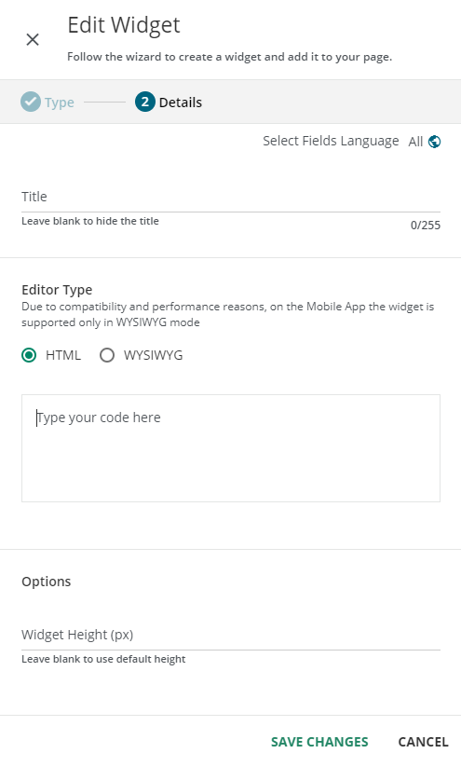
Step 3 Paste Framework into HTML Widget editor
Make sure the Editor Type “HTML” is selected
Paste framework into editor field.
1
2

Slide 7
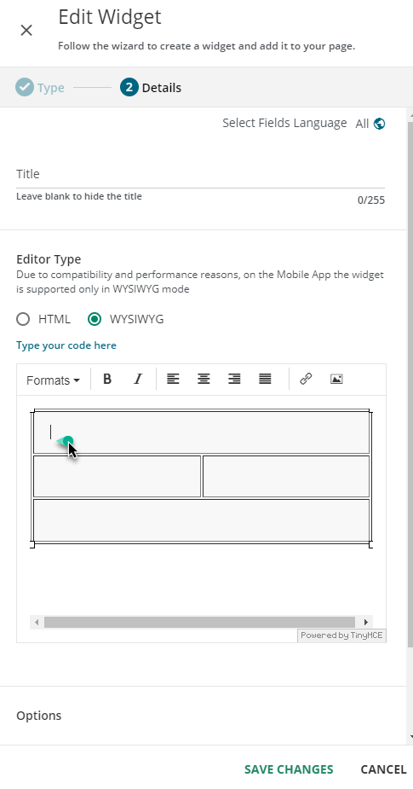
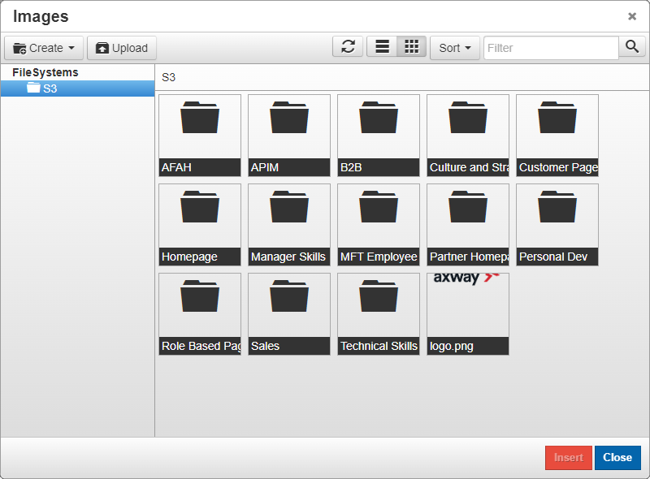
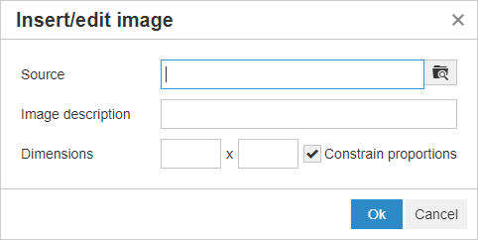
Step 4 Add images and Links
Select WYSIWYG as the editor type
Put the cursor on the area of the framework you would like to add an image by clicking into the spot on the editor window
Click the Image icon
Click the File source icon
Search for existing image or upload a new image (details in next slides)
1
3
2
4
5

Slide 8
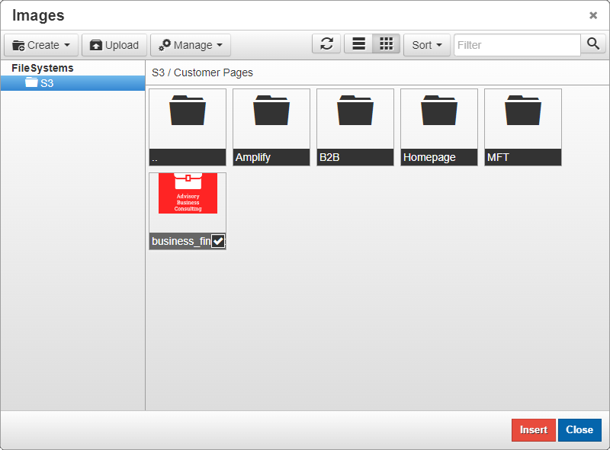
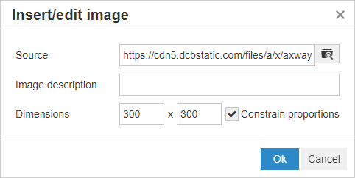
Step 4 Add images and Links (search existing image)
From the images window, click on the folder in which the image is saved
Click on the image to select it
Click Insert
Add an image description (required for accessibility assistance)
Adjust dimensions (optional)
Click OK
1
2
3
4
5
6

Slide 9
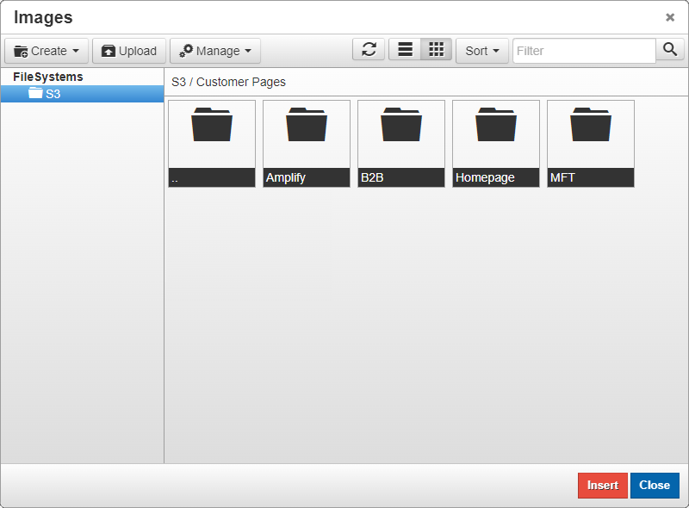
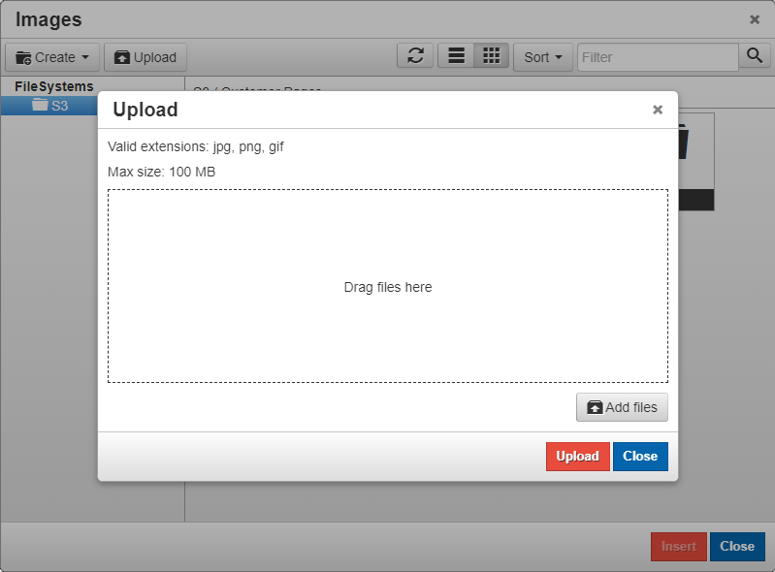
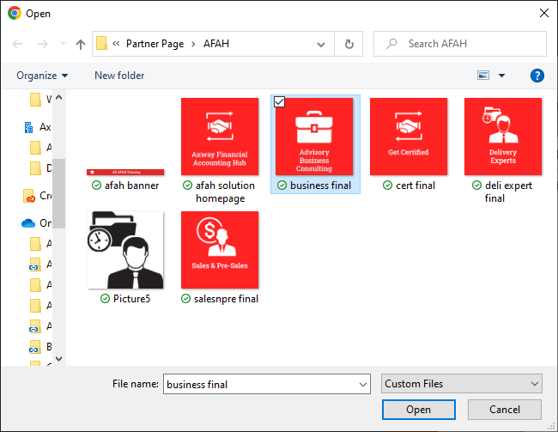
Step 4 Add Images and Links (add a new image)
From the images window, click on the folder in which you would like the image to be saved or create a new folder
Click Upload
Click Add Files
Select files from File Explorer
2
1
3
4

Slide 10
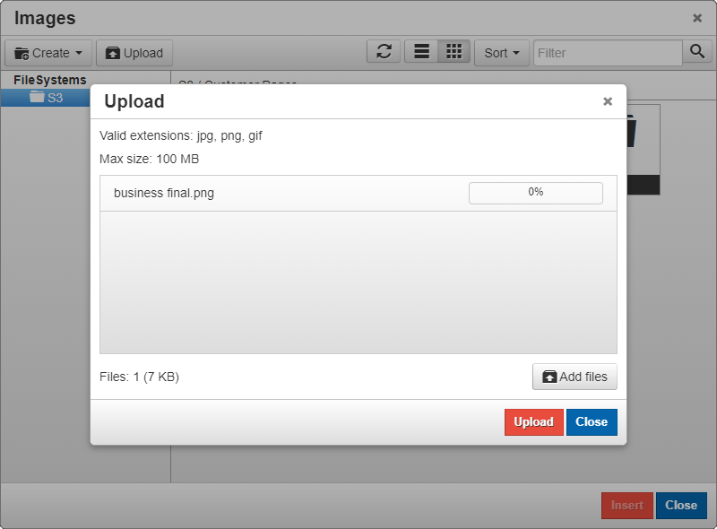
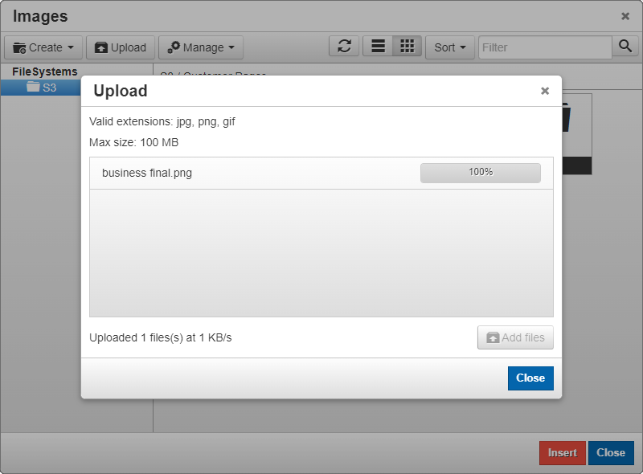
Step 4 Add Images and Links (add a new image) Cont.
Click Upload
Once upload is complete, click Close
5
6

Slide 11
Step 4 Add Images and Links (add a new image) Cont.
Select image to insert to widget (if not already selected)
Click insert
Add an image description (required for accessibility assistance)
Adjust dimensions (optional)
Click OK
7
8
9
10
11

Slide 12
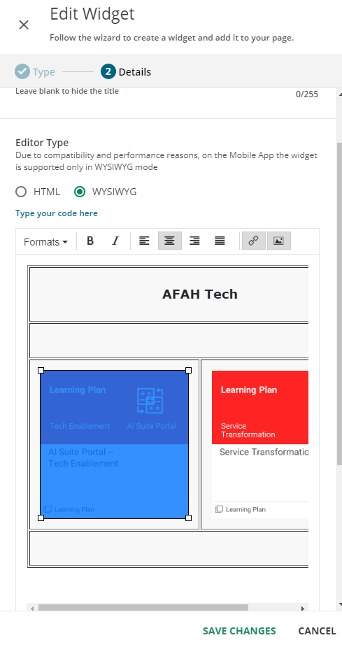
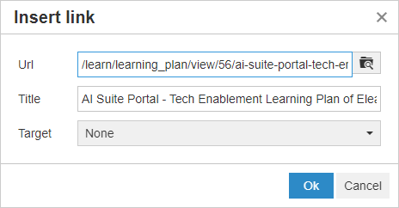
Step 4 Add Images and Links (add a link) Cont.
Select the image you just added to the widget, and click the link button
Add the URL you are linking
Add the title of the page you are linking to
Select the target:
None – Link will open in same window
New Window – Link will open in new tab/window
Click OK
Once finished making changes to HTML widget, click Save Changes
12
12
13
14
17
15
16

Slide 13
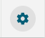
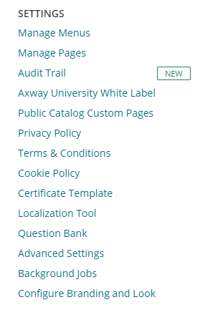
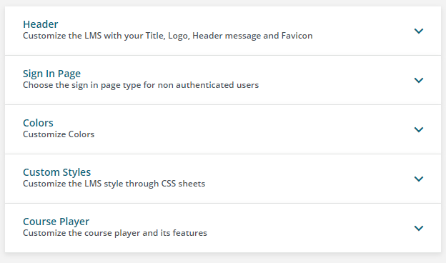
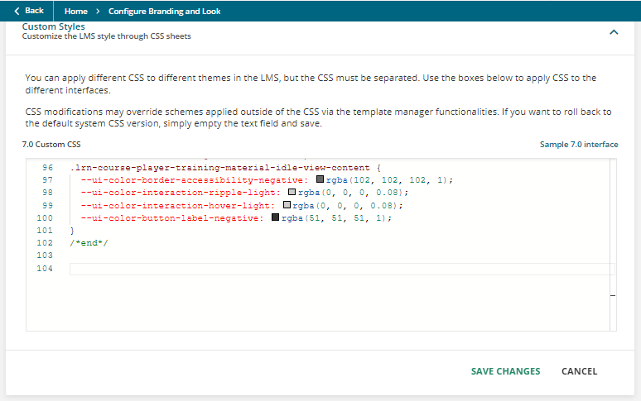
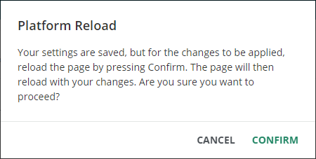
Step 5 (Optional) Add CSS to be used for HTML
1
Access the Configure Branding and Look page from the Admin menu
Open the Custom Styles Section
Add your CSS in the 7.0 Custom CSS section
Please add your initials and date added in a comment on the CSS
Click Save Changes
Click Confirm on pop-up dialog
2
1
3
CSS entered here will also impact CSS being used by Docebo for the platform. Please use unique properties that will not impact any existing CSS. (As a general rule, use the prefix “AU” on your property)
5
4

Slide 14
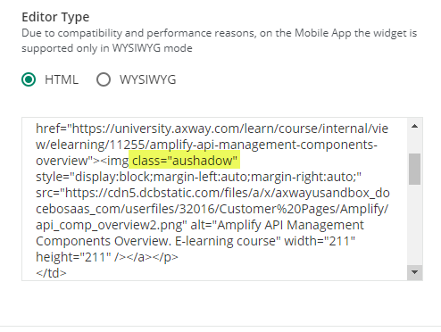
Step 6 Update HTML for CSS as necessary
Return to the HTML widget editor
Update HTML code to include the CSS attributes
For example – images on Customer pages use CSS for image shadow, all images have the CSS class “aushadow” added to it

Slide 15
Summary
Use an html editor like Dreamweaver or Notepad to build the framework for your widget
Construct tables, add style elements, etc..
Add a new HTML widget to a page or access existing widget
Copy/paste your framework from the html editor software to the HTML editor option of the widget
You need to use the WYSIWYG option to add images
Add CSS to the Configure Branding and Look section of the platform
Update HTML as necessary for the CSS

Slide 16
Tips and Best Practices

